Slide 1
Ecommerce Customers Sales Predictions
by Munusamy Minnel Perumal

Slide 2



Prediction for a Company
The company is trying to increase their annual revenues based on:

Slide 3

MOBILE PROJECT
Whether to spend their efforts on a Mobile

Slide 4

WEB PROJECT
Whether to spend their efforts on web page

Slide 5
About Dataset:
Kaggle: The dataset is from Kaggle
Dataset: https://www.kaggle.com/teberle/e-commerce-linear-regression/data
DataSet Features:
Email
Address
Avator
Avg. Session Length
Time on App
Time on Website
Length of Membership
Yearly Amount Spent (Our Target)

Slide 6

Data Clean Up
Removing the objects columns that is not useful for our predictions.
Email, Address and Avator

Slide 7
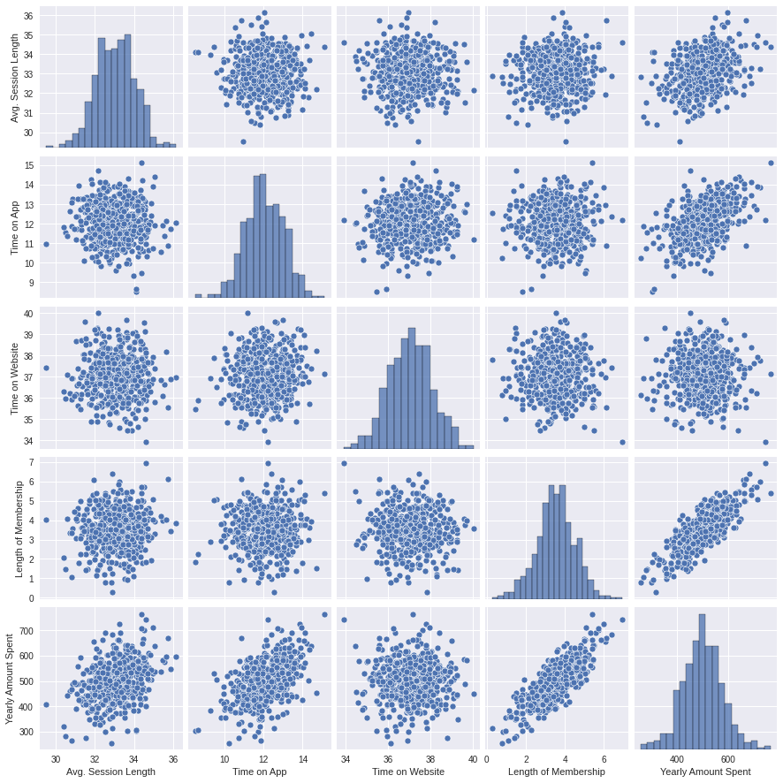
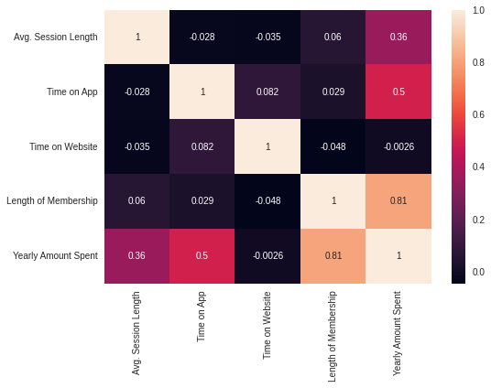
Correlation Heatmap PairPlot

Slide 8
Train - 98.52%
Test - 98.06%
Mean Absolute Error: 8.4604
Mean Squared Error: 105.6451
Root Mean Squared Error: 10.2783

Slide 9
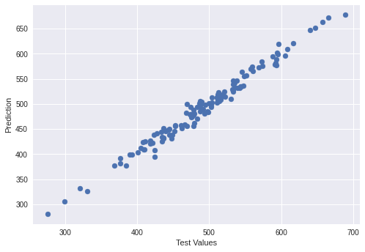
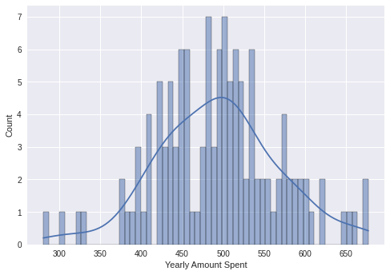
Prediction Based on Linear Regression

Slide 10
Conclusion
From this Linear Regression Model to predict the annual revenues whether to focus on the app or the website, I see both are not a great choice to decide. The Length of Membership determines the Annual Revenues.

